Slide 1

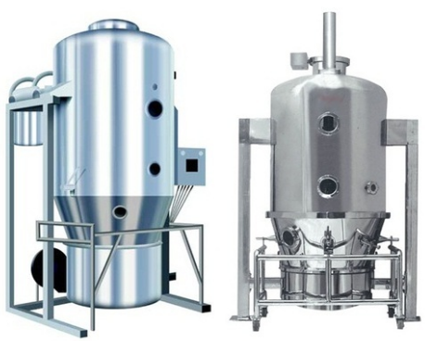

FLUID BED DRYER
Mfg.& Exp. Of Plants & Machineries for Pharmaceuticals,
Cosmetics, Chemicals food & Beverage Industries
Plot No. 1601/1,3rd Phase G.I.D.C., Vapi-396195. (Gujarat)
Email:sales@sidhipharmaequiment.com:sidhipharmaequipments@gmail.com:
Contact Person : Mr. Pravin Panchal (9924893790) Mr. Kiran Gophane (9545868896)
Website: www.sidhipharmaequipment.com

Slide 2
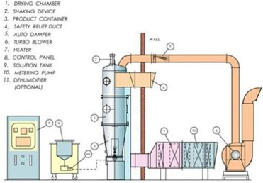
Fluidized Bed Dryer :
Fluidized bed dryer (also called fluid bed dryer) is a kind of equipment used extensively in the pharmaceutical industries to reduce the moisture content of pharmaceutical powder and granules. The equipment works on a principle of fluidization of the feed materials. In fluidization process, hot air is introduced at high pressure through a perforated bed of moist solid particulate. The wet solids are lifted from the bottom and suspended in a stream of air (fluidized state). Heat transfer is accomplished by direct contact between the wet solid and hot gases. The vaporized liquid is carried away by the drying gases. Sometimes to save energy, the exit gas is partially recycled

Slide 3
Silent Features :
In compliance with cGMP guidelines
Modular Design
Uniform Drying with reducing Drying time
Quick Dismantling of Dutch Sieve & Perforated Sheet at the Product container
Online Sampling Device (optional)
Fully Automatic Operation through Programmable
Logic Controller (optional)
Product Container with Stirrer (optional)
Flameproof Construction (optional)
Advantageous\ Benefits :
Easy operations , Faster and uniform drying
Easy maintenance
Overcomes typical problems associated with drying, such as, Improper drying, Fine generation, Excessive drying time
High quality and better shelf life of the product

Slide 4
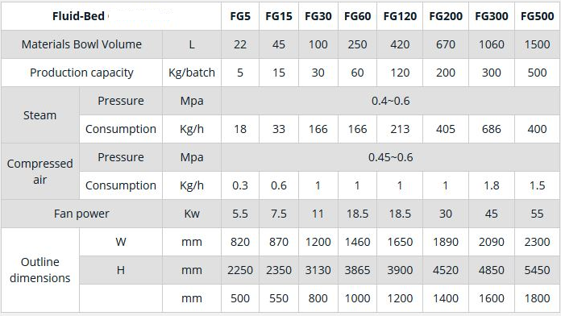
Technical Specification :
Single Source Provider for all your technical requirements.
One of the most important “Siddhi Pharma Equipment” guideline is to be closest to our Customers. We strive to create end-to-end solutions that meet our clients needs and their expectation.
Application :
Pharmaceutical
Food
Chemical
Cosmetics
Allied Industry

