Slide 1

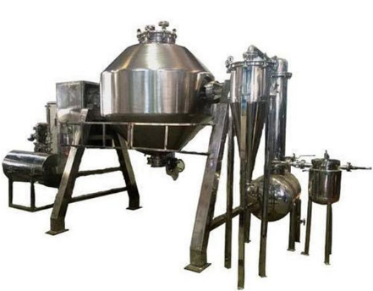

ROTO CONE VACCUM DRYER
(RCVD)
Mfg.& Exp. Of Plants & Machineries for Pharmaceuticals,
Cosmetics, Chemicals food & Beverage Industries
Plot No. 1601/1,3rd Phase G.I.D.C., Vapi-396195. (Gujarat)
Email:sales@sidhipharmaequiment.com:sidhipharmaequipments@gmail.com:
Contact Person : Mr. Pravin Panchal (9924893790) Mr. Kiran Gophane (9545868896)
Website: www.sidhipharmaequipment.com

Slide 2
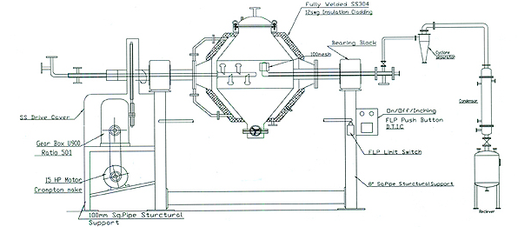
DOUBLE CONE VACUUM DRYER :
The DOUBLE CONE VACUUM DRYER also utilizes the vacuum drying technology with greater drying efficiency. Wet product goes through an indirect heating process and agitation with tumbling action, all while inside a vacuum to achieve rapid drying. In this process, recovery of solvent is also possible through condensation processes.
With constant innovation, the RVCD manufacturer has been able to deliver highly precise models that achieve thorough drying of product, uniformity of products, reduced drying time and an easy to clean and maintain machine. The roto cone vacuum dryer is mainly used in chemicals processing and pharmaceutical industries where air contamination can easily occur with other types of dryers.

Slide 3
Silent Features :
Dry Mechanical Seal for vacuum side.
Dry Mechanical Seal for Waterside.
FLP Motor & FLP Control panel enclosed in SS304 panel.
Digital Temperature Indicators (FLP) at Hot Water inlet and outlet.
Digital Temperature Indicator (FLP) and Dial Vacuum Gauge in vapor line.
Digital Temperature Controller (FLP) with Pneumatic Valve at Hot water inlet.
Provision for Nitrogen purging Vacuum release with interlocking to isolation valve.
Temperature and Vacuum Gauges (Dial Type) on Cone.
Safety Guard/railing telescopic type with limit switch (FLP) with interlocking.
Drain plug and safety valve on HW/Steam Jacket.
Pulse jet type dust filter is provided in side the cone.
Positioning wheel /inching button for cone.
Advantageous\ Benefits :
Reduces drying time
Eliminates need for re-drying of lumps
Handling and exposure of final product is avoided
Gives uniform size dry product. System can process crystalline or amorphous powders which are prone to lumps
Easy to clean internal surface ensures purity of product . Optimum and continuous vacuum maintenance during process
Uniform material shuffling over the heated contact surface of the cone.

Slide 4
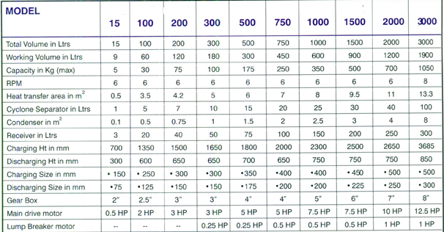
Technical Specification :
Single Source Provider for all your technical requirements.
One of the most important “Siddhi Pharma Equipment” guideline is to be closest to our Customers. We strive to create end-to-end solutions that meet our clients needs and their expectation.
Application :
Pharmaceutical
Food
Chemical
Cosmetics
Allied Industry

