Slide 1
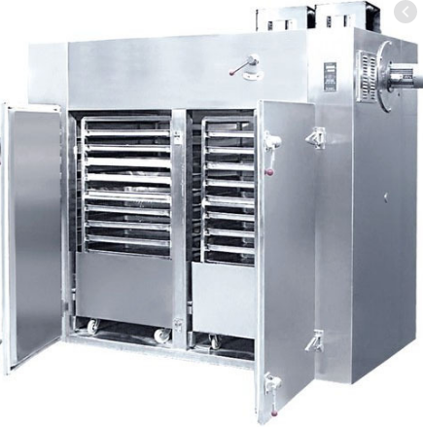
TRAY DRYER
Mfg.& Exp. Of Plants & Machineries for Pharmaceuticals,
Cosmetics, Chemicals food & Beverage Industries
Plot No. 1601/1,3rd Phase G.I.D.C., Vapi-396195. (Gujarat)
Email:sales@sidhipharmaequiment.com:sidhipharmaequipments@gmail.com:
Contact Person : Mr. Pravin Panchal (9924893790) Mr. Kiran Gophane (9545868896)
Website: www.sidhipharmaequipment.com

Slide 2
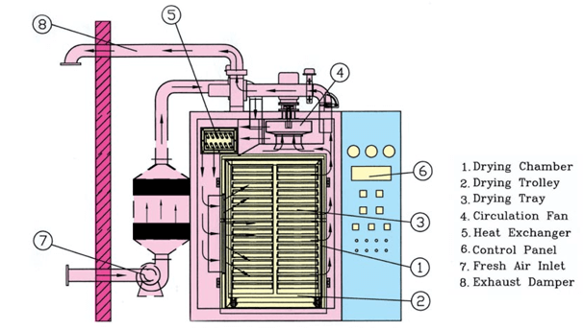
TRAY DRYER :
TRAY DRYER Working Principle – A dryer utilized for drying of the wet products like crude drugs, chemicals, powders or the granules, etc. is known as tray dryer. A laboratory oven is the elementary form of it which contains a cabinet with a heater at the bottom. The values of these ovens are very less because of its uncontrollable heat transfer or humidity meter.
When we fit a fan in the oven, the circulation of the forced hot air gets started. This process is beneficial for reducing the local flour concentrations and also for increasing the heat transfer. The directed circulation form is the best type of a tray dryer. In these Dryers, the air is heated and then focused on the object in a controlled flow.
The material which we want to dry is dispersed on the tiers of the trays. The tray, which is used in this process must have perforated, solid or wire mesh bottoms. For the circulation of the air across the drying materials, we lined the screen trays with paper. A limited amount of heat is provided to every shelf at that time when the wind passes over it to provide the latent heat of vaporization. This kind of dryers provides proper control of humidity and temperature.

Slide 3
Silent Features :
Uniformity in drying and reduction in drying time.
In Electrically heated model, digital temperature controller for inlet air and digital temperature indicator for outlet air.
In steam /Electrically heated model, only a digital temperature indicator provided for inlet and outlet air
You can control the flow of inlet and outlet air manually
Full safety provided with the machine
Flameproof Construction (optional)
Available in 24, 48, 96 & 192 Trays.
Design is cGMP - Current Good Manufacturing Practices
compliance.
Advantageous\ Benefits :
Each batch is handled as a separate entity.
It's more efficient in fuel consumption.
It's operated batch-wise.
It's simple to use.
It provides tendency to over-dry the lower trays.
It requires little labor costs – merely load and then unload.

Slide 4
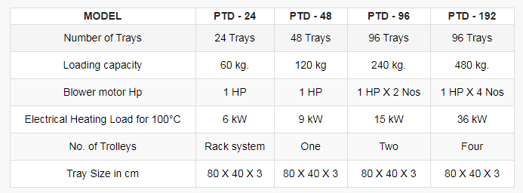
Technical Specification :
Single Source Provider for all your technical requirements.
One of the most important “Siddhi Pharma Equipment” guideline is to be closest to our Customers. We strive to create end-to-end solutions that meet our clients needs and their expectation.
Application :
Pharmaceutical
Food
Chemical
Cosmetics
Allied Industry

