Slide 1
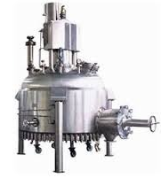
AGITATED NUTSCHE FILTER/DRYER
Mfg.& Exp. Of Plants & Machineries for Pharmaceuticals,
Cosmetics, Chemicals food & Beverage Industries
Plot No. 1601/1,3rd Phase G.I.D.C., Vapi-396195. (Gujarat)
Email:sales@sidhipharmaequiment.com:sidhipharmaequipments@gmail.com:
Contact Person : Mr. Pravin Panchal (9924893790) Mr. Kiran Gophane (9545868896)
Website: www.sidhipharmaequipment.com

Slide 2
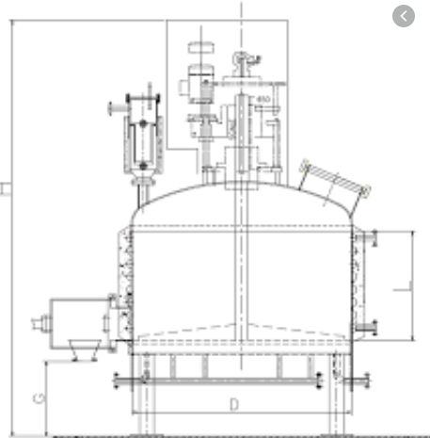
AGITATED NUTSCHE FILTER/DRYER:
The Agitated Nutsche filter is a Nutsche type filter designed to separate solids from liquids under controlled conditions. It is totally enclosed and is normally operated under pressure or under vacuum. Additionally , the equipments is fitted with a stirrer mechanism which efficiently agitatates the slurry during cake washing, smoothens and squeezes the cake during filtration and assists in the automatic discharge of the cake. The ANFD comprises of a pressure vessel in which a main shaft rotates and also moves in the vertical direction. Specially designed stirrer blends are mounted on the shaft, capable of performing various functions. A side discharge arrangement is provide, closing and opening through hydraulic / mechanical means.
This is a combination of Filter and Dryer unit in single equipment to achieve economy in process and energy thereby improving profitability.

Slide 3
Silent Features :
The Filtration process is very Fast
Significant squeezing of filter cake is possible
Enables easy,non-manul and automatic cake/ solid discharge. Scraper blade can be provided to scrap the material which may stay on shell.
The unit is designed with minimum maintenance features.
Hollow shaft for drying
Specially designed tank cleaning CIP nozzles provided for through cleaning of inside of filter body.
Hinged type quick openable discharge valve cover provided.
The equipment can perform as reactor- crystallizer, also presense of catalysis.
Advantageous\ Benefits :
Processing of concentrated suspensions
Cake filtration
Cake washing and cake purification
Extraction of active agents from organic solids
Filtration plants with product and solids processing
Filter-dryer plants with solvent recovery unit

Slide 4
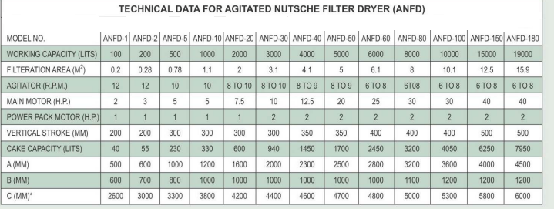
Technical Specification :
Single Source Provider for all your technical requirements.
One of the most important “Siddhi Pharma Equipment” guideline is to be closest to our Customers. We strive to create end-to-end solutions that meet our clients needs and their expectation.
Application :
Pharmaceutical
Food
Chemical
Cosmetics
Allied Industry

